Slide 1
Politics and Vaccinations in America
Edwin Hicks, Ilja Afanasjevs, Aniket Kamlender Maheshwari, Dennis Kyalo

Slide 2
Introduction
Vaccinations are a hot topic, especially now with the booster shots becoming available
We are interested in comparing political orientation and vaccination rates in America
Notes:
Vaccinations are a hot topic in America, especially now that the booster shots are becoming available. We are interested in seeing if there is any connection between political orientation, and the decision to be vaccinated in America.

Slide 3
Political Orientation
The simplest way to determine the political orientation of America is to break it down into states.
To do this, we used the 2020 presidential election results
The votes from the election dataset were split by county
Notes:
Political orientation is very complicated. We decided to generalize the overall political views of America state by state. Using data from the 2020 election, we can see the overall political position of a state by which presidential candidate won the popular vote. We will also look at the major political parties involved, as well as which states voted the most. The election data was given by county, so we grouped each county into their respective states to determine the overall state political orientation

Slide 4
Vaccinations
We will use state vaccination data to compare to the election data
We will also look at which states have the most vaccinations distributed, as well as which states have the best vaccination efficiency.
Notes:
We will compare our findings from the election dataset with vaccination data for each state. The vaccination dataset that we used had lots of vaccination information for each state, including the number of vaccinations distributed, the number of vaccinations actually used, and the number of people fully vaccinated.

Slide 5
Database Normalization Process
Two CSV files from source:
Vaccination Statistic file (by state, by date)
Election result statistics (by States, regions, candidate and party)
DB Normalization improves data quality and makes easier SQL query writing
For normalization we used plain Python code, without libraries:
Read file line by line
Used strip() and split() functions

Slide 6
Normalization Overview
From Vaccination CSV file we created 2 SQL tables:
Vaccination (Vaccination stats, Foreign Key Location table)
Location (LocationID and LocationName)
From Election CSV file we created 5 SQL tables:
Candidate (CandidateID and Candidate Name)
County (CountyID and CountyName)
Party (PartyID and Party Name)
LocationElection (Location ID and State name)
ElectionRes (Election results with 4 Foreign keys)

Slide 7
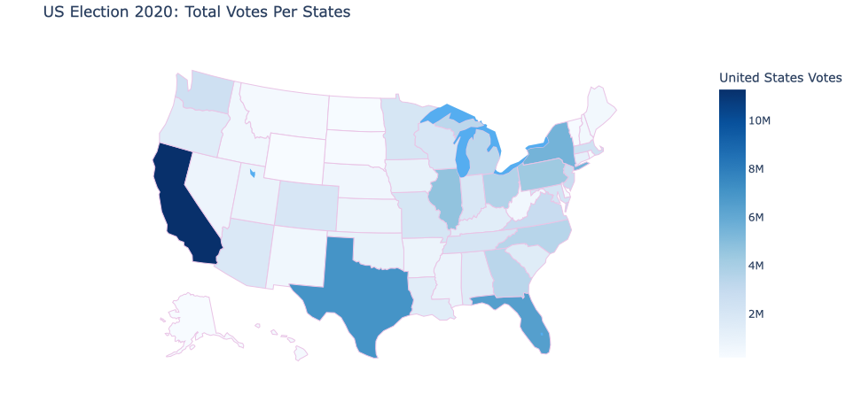
Full-width Image
Notes:
This is the total votes per state. California, Texas, Florida, and New York voted the most in the 2020 election.

Slide 8
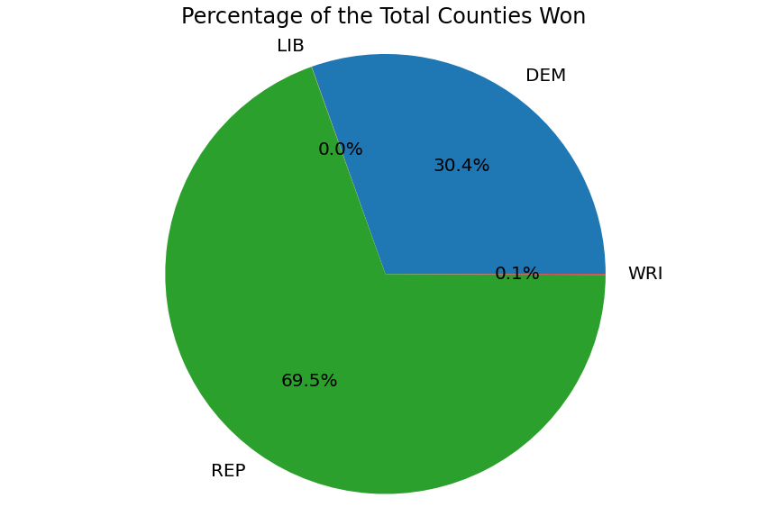
Notes:
This graph shows the percentage of counties won by each political party. While the republican party won more total counties, they still lost the overall election. This is due to the fact that some counties are more populated than others.

Slide 9
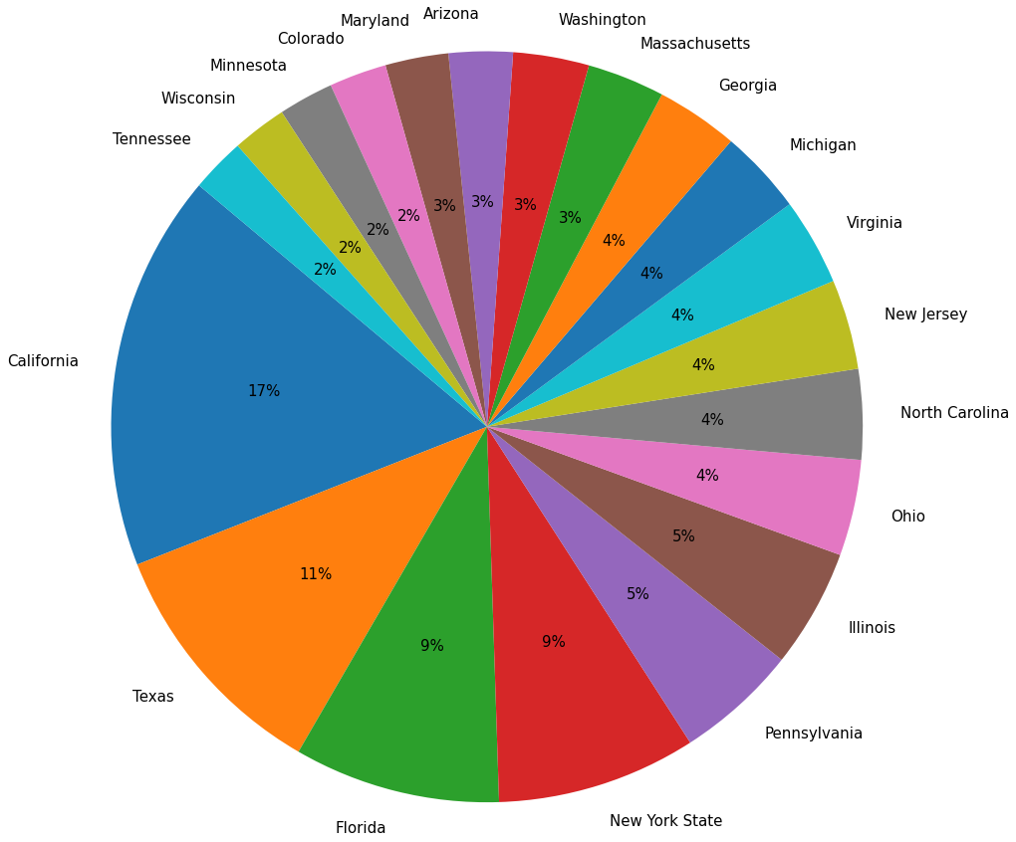
Notes:
This graph shows the total vaccinations distributed for the top 20 states. The top 4 states here were also the states with the most total votes for the election. Again, this makes sense considering these are the most populated states

Slide 10
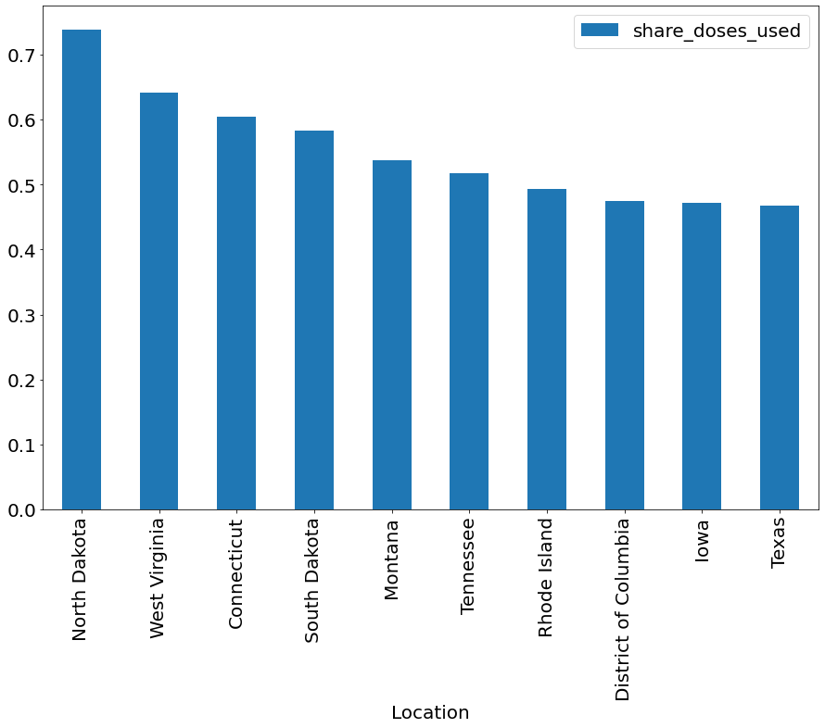
Notes:
This graph shows the vaccination efficiency for each state. share_doses_used is the number of vaccinations used per the number of vaccinations distributed. The other states hover around .5 or lower, meaning they use half or less than half of the vaccinations that they are given.

Slide 11
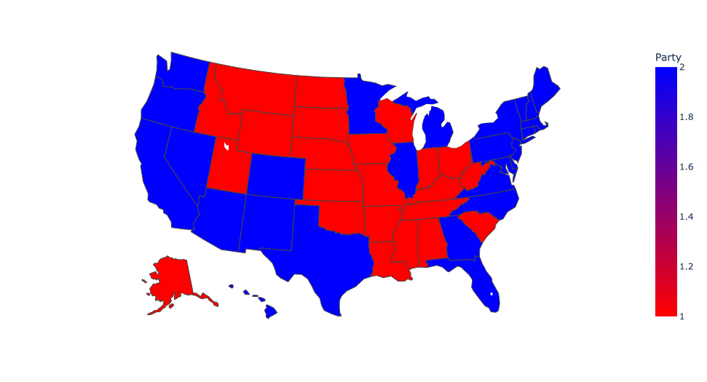
Notes:
This map shows the overall political orientation of each state. Red is for the Republican party, and blue is for the Democratic party.

Slide 12
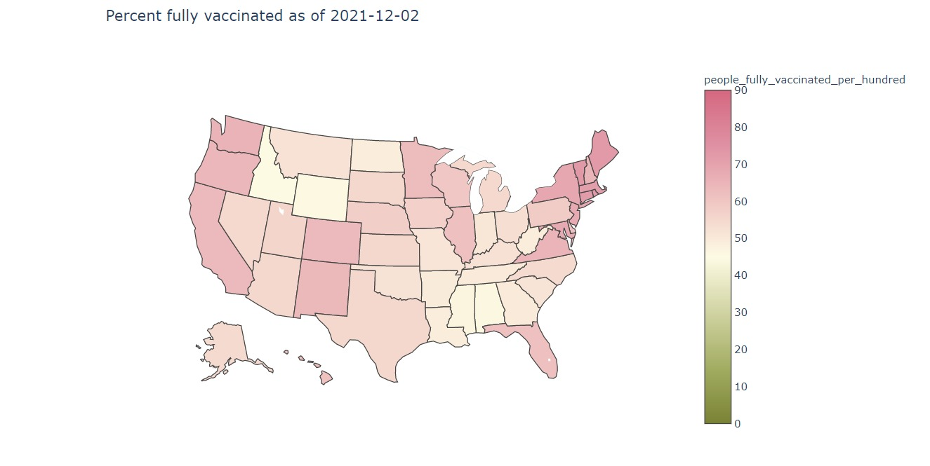
Notes:
This map shows the ratio of the number of people vaccinated per 100 people for each state. Every state is above 40% for people fully vaccinated.

Slide 13
Map Comparison
Notes:
Here is the final map comparison. There does seem to be a pattern shared between the two maps. The west and east coast states are mostly blue states, and also seem to have a higher percentage for full vaccinations. The middle states are mostly red states, and seem to have a lower percentage for full vaccinations. However, there are some outliers such as Nevada, Texas, and Georgia.

Slide 14
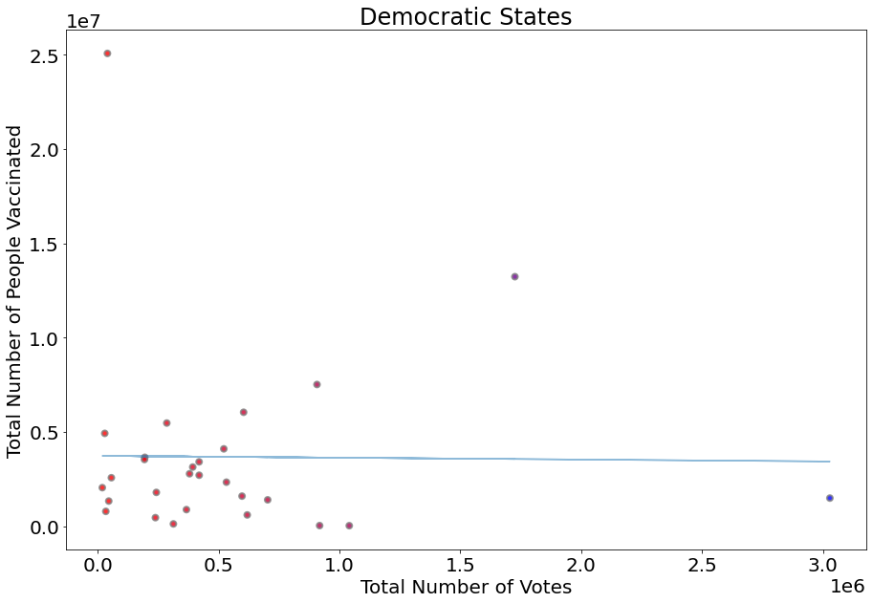
Notes:
This graph shows the relation between the total number of people fully vaccinated and the total number of votes for the blue (Democratic) states. There is no clear trend here, and the slope of the graph is basically 1.

Slide 15
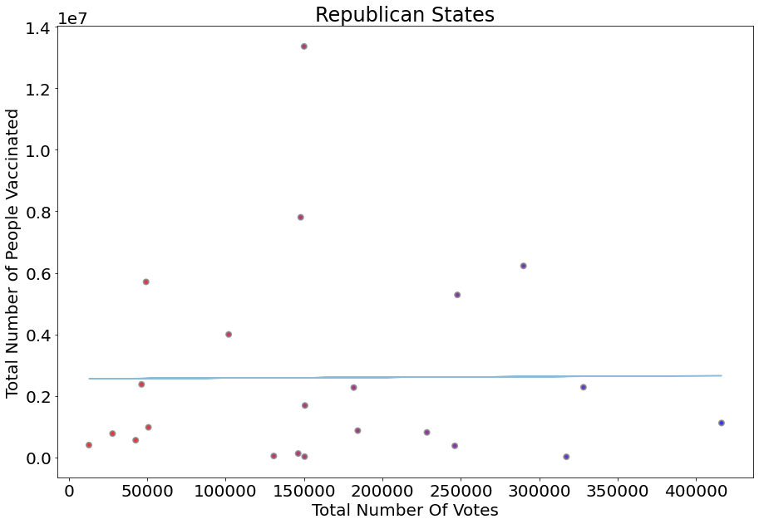
Notes:
This graph shows the relation between the total number of people fully vaccinated and the total number of votes for the red (Republican) states. There is also no clear trend here, and the slope of the graph is 1 again.

Slide 16
Conclusion
From the slopes of the last two graphs, there does not seem to be a correlation between political and vaccination stances
From the map comparison, we showed that the democratic states have a slightly higher percentage of people fully vaccinated on average
Notes:
The scatterplots of people fully vaccinated vs total votes for the red and blue states did not yield any kind of connection. The choropleth map comparison showed some connection between political views and vaccination rates, implying that democratic states have a slightly higher vaccination rate than republican states.

